Slide 1
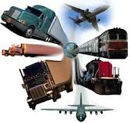
ISTANBUL
TRANSPORTATION
Grade 9

Slide 2
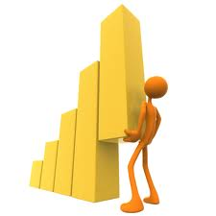
Content areas are
Statistics
Graphs
Main content area is Statistics.

Slide 3
LECTURE
To arouse curiosity, the lesson will start with conversation about students’ like.
EX: favorite color, favorite movie …

Slide 4
What do you want to learn about your peers?
Preparing a question.
Aim: To direct students explore the usage of statistics in real life by collecting their own data

Slide 5
What is your favorite fruit?
SAMPLE
 | Male | Female
Apple | 3 | 5
Melon | 7 | 8
Orange | 6 | 5
Strawbery | 6 | 9
Cherry | 4 | 7

Slide 6
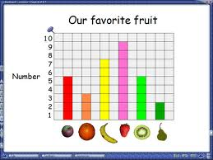
GRAPHS
By this way, students try to categorize their own data.
They need to figure out their data systematically by using different tools; technology, visuals etc.
aim: to create their own categorization system and to discover the drawing graphs.

Slide 7
Brainstorming
As far as, students realize
usage of statistics in real life
saving and categorizing their own data
visualize their data by graphs
Now, they need to share and discuss the different approaches that they use.
EX: Generally, people who love rock music prefer to watch horror films.
Aim: to develop interpretation skills

Slide 8
Teacher’s Roles
to facilitate students learning,
to direct students with Socratic questions,
to manage time
to provide ss on task

Slide 9
Student Evaluation
Interdisciplinary project about İstanbul.
Subtheme is Transportation.
Students are expected to prepare an investigation for tourist guides. At the end of your investigation, they have to make interpretation future transportation and try to find solution for the traffic problems in İstanbul.

Slide 10
Instructions
Each group ( of 3-4) choose their own rote that is started from a touristic place in Anatolian side to European side of Istanbul.
Construct a survey about transportation.
Search about past years transportation.
Interpret your findings based on your survey result.
Make future interpretation.

Slide 11
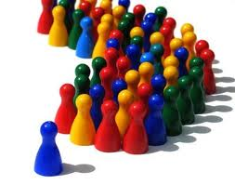
Ss are expected to show their work creatively and effectively.
It could be
A presentation
A report
A video record
A poster
A magazine article … etc

Slide 12
Students will be evaluated
By their peers
By teachers
With meetings
Students’ work etc.

Slide 14
Thank you….

